Slide 1
US Lacrosse Girl’s Rules
SJYLL YOUTH RULES

Slide 2
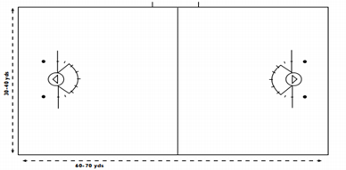
Field 8U
60-70 yards X 35-45 yards
1. Goal Circle (may use small cones)and Goal Line
2. 8m
3. Center Line
Field Players 7 v7 NO goalie
Off sides is enforced at this level, holding 2 players back at midline is required
8U
3 seconds not in effect, defense players must play
1v1 including in the arc
(minor foul)
X
X
X
X
X
X
X
2 small circles (dots) 5-6 in. diameter, behind each goal- 5 yds. from the goal line extended and in line with the 8m arch. Painted white or contrasting color may be temporary substance spray paint, chalk…

Slide 3
Field 10U
60-70 yards X 35-45 yards
1. Goal Circle and Goal Line
2. 8m
3. Center Line
Field Players 7 v7 plus a Goalie
Off sides is enforced at this level, holding 2 players back at midline is required
X
X
X
X
X
X
X
X
2 small circles (dots) 5-6 in. diameter, behind each goal- 5 yds. from the goal line extended and in line with the 8m arch. Painted white or contrasting color may be temporary substance spray paint, chalk…

Slide 4
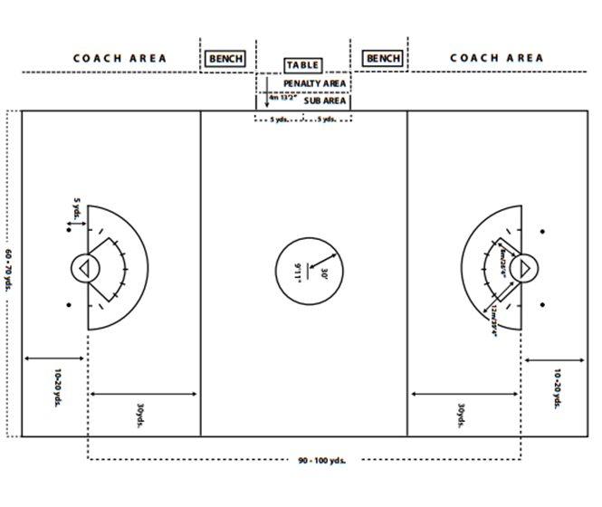
Field 12U - 14U
Table: required a visible possession indicator. It may be a small cone or other object move side to side indicate possession pointing to direction of offense
Restraining line
Restraining line
X
Critical Scoring Area from the 12m extended to the endline
X
X
X
X
X
X
X
X
X
X
X
2 small circles (dots) 5-6 in. diameter, behind each goal- 5 yds. from the goal line extended and in line with the 8m arch. Painted white or contrasting color may be temporary substance spray paint, chalk…

Slide 5
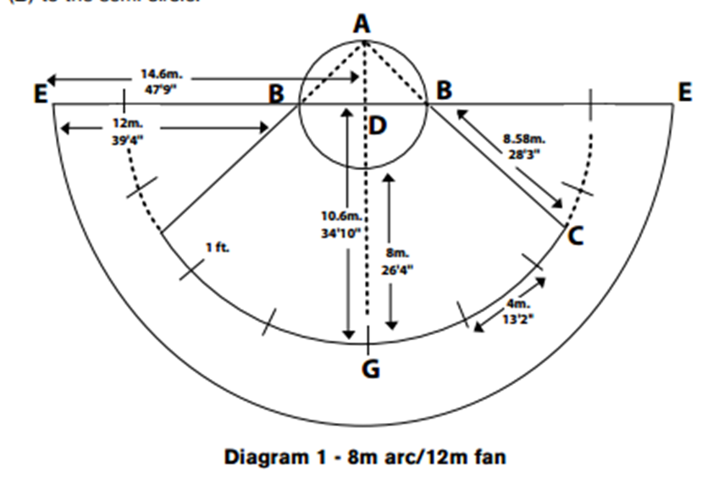
Directions for 8m and 12m Fan
5 yards

Slide 6
Equipment
Pre-Game
Captains meeting: coin toss select direction or possession arrow
Coaches verify players are legally and properly equipped
Equipment check
Players line up
12U-14U Regulation sticks need to see the top of the ball above the top of the crosse’s wall. Recessed screw must be used
8U-10U Regulation sticks with modified pockets Recessed screw must be used
Field Players No Mesh
Shorter stick length to fit player's arm
Modified pocket no more than half of the ball may fall below the bottom sidewall

Slide 7
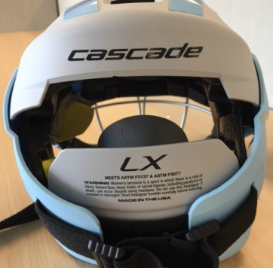
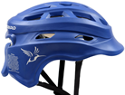
Equipment
FIELD PLAYER:
ASTM standard F3077 eye protection
NEW -may wear a helmet
ONLY ASTM standard F3137
Cascade and Hummingbird
Cascade has attached the ASTM F3077 googles with the helmet
Hummingbird ASTM 3137 only
SOFT
HEADGEAR
NOT
APPROVED
NOT ALLOWED

Slide 8
Equipment
Fitted mouthpiece:
no protruding tabs do not use attachment to googles
no graphics of white teeth
any color but white or clear
Stick
8U & 10U women’s crosse, may have a modified pocket
12U & 14U women’s crosse, regulation pocket

Slide 9
Equipment
GOALIE:
Helmet with face mask (NOCSAE), chinstrap
Separate throat protector
Fitted mouthpiece
Padded gloves, chest protector, padded shins and thighs
Recommended padding on arms and shoulders
Goalie stick Recessed screw must be used
FACIAL ADORNMENT: eye black worn on the face must be one solid stroke no logos, writing, numbers and shall be the length of the eye socket and above the cheekbone

Slide 10
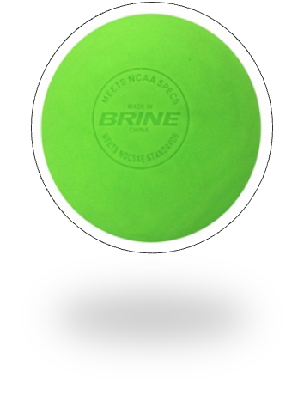
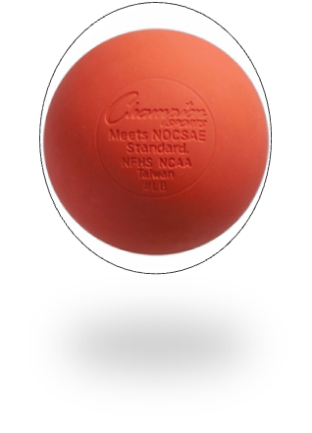
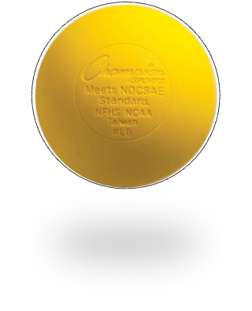
Equipment
Ball:
Must meet NOCSAE Standards, game may only be played with a NOCSAE ball
must be lime green, yellow or orange
(no white)
8U – may use regulation
or soft ball

Slide 11
Duration of Play
8U-10U
2 – 20 minute halves, running clock (SJYLL)
stop on whistles the last 2 minutes (SJYLL)
Half time 5 minutes
1 Time Out running clock/ No Time Outs last 5 min of half
Play out 8m direct shots – only 10U not the 8U (no goalie)
12U-14U
2 – 25 minute halves, running clock (12U - SJYLL)
stop on whistles the last 2 minutes
Half time 5 minutes
1 Time Out running clock/ No Time Outs last 5 min of half
Play out 8m direct shots

Slide 12
Starting/Restarting with the Draw
10U, 12U, 14U Start the game and restart after a goal
8U NEW Draw only at the start of each half, no draw after goal restart on the goal line extended (SJYLL)
8U and 10U NEW only 1 player between 8m during draw (all others are in the 8m) must wait until one team gains possession. 3 players will be placed on the 8m offensive end and 3 players on the 8m defensive end. The 7th field player will be at the center to take the draw
12U-14U: Only 3 players in between the restraining lines during the draw players must wait until one team gains possession before touching or crossing RL

Slide 13
Starting/Restarting with the Draw
The Draw: each stand with one foot toeing the center line.
Crosse held above hips, right side of crosse is the lower side closest to the field, open crosse facing their defending goal, the ball is positioned upper third at the widest point.
On “ready” the players must be motionless, may only move their heads, otherwise illegal
On whistle they draw upward
The ball must go over their heads, if not redraw.

Slide 14
8U-10U Starting/Restarting the Game with the Draw
NEW 3 players will be placed on the 8m offensive end and 3 players on the 8m defensive end. The 7th field player will be at the center to take the draw.
X
X
X
X
X
X
X
Players must hold in the 8m until the official has signaled possession

Slide 15
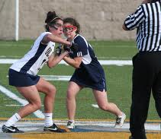
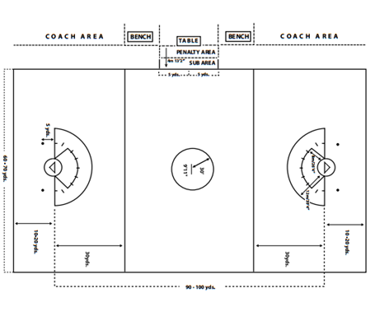
Starting/Restarting the Game with the Draw 12U – 14U
Corner
Flags
X
X
X
X
X
X
X
X
X
X
X
Restraining line
Restraining line 30 yds from goal line
Players must hold below restraining line until the official has signaled possession

Slide 16
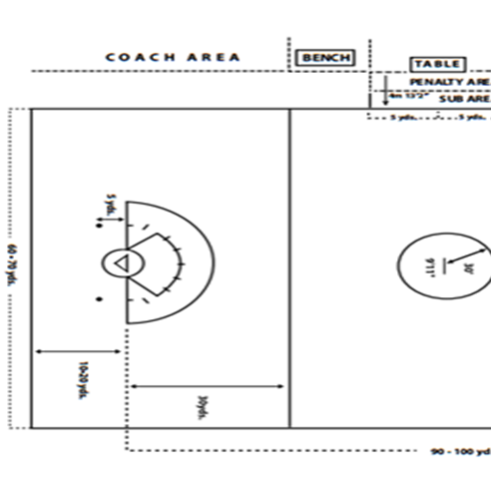
Coaching Area
Coaching Area
14U - 10U: Coaches may go
from Sub Area to End Line
on their own half.
8U – One coach from
each team is allowed on the
field for the purpose
of instructing players.
Violation is a Misconduct Foul
X
X
X
X
X
X
Restraining line

Slide 17
Out of Bounds
Out of Bounds, last to touch, opponents get the ball
Hard Boundaries
Corner flags
X
X
X
X
X
X
X
X
X
X
X
On missed shots, deflected shot
closest player to the ball gains possessions

Slide 18
Goal Circle Foul
Goalie has
10 seconds to clear the ball
1. Only the goalie is allowed in the goal circle NO DEPUTY
GOAL CIRCLE FOUL
Minor foul
X
X
X
X
X
X
X
X
X
X
X

Slide 19
Goalie and the Goal Circle
Goalie
has
10 seconds to clear
the ball
Goalie leaves the circle
1. she loses goalie privileges .
2. She may only re-enter without the ball
3. Once “played” by defense she may propel the ball into circle then follow it in.
4. She must return to goal circle if the ball is inside circle.
X
X
X
X
X
X
X
X
X
X
X

Slide 20
Substituting
Sub Area; should be marked or coned
Rolling subs
Must wait until player leaves the field before sub enters.
May sub
after a goal.
X
X
X
X
X
X
X
X
X
X
X

Slide 21
Alternate Possession
Winner of coin toss will select either direction or initial alternating possession arrow
NEW Arrow points to the offensive end for team, switch arrow direction at half time
Alternate possession record will be kept at the table
Offsetting fouls
Offsetting fouls during a draw –redraw do not use the arrow
Ball lodges in field players clothing
Ball goes into goal off non player
Out of bounds ball two opposing players equally close
Games restarted for incidental reason no team in possession

Slide 22
Penalty Administration
Green Card: minor foul
Green/Yellow Card: major foul (does not count towards team total)
Green/Red: major foul and offender goes to penalty area for 2 minutes and a sub takes her place
Yellow Card: 2 minutes in penalty area.
8U-10U substitute must take her place, team does NOT play short
12U-14U team plays short
A team which accumulates 4 yellow cards plays short the remainder of the game, and for each additional yellow another player is removed from the field

Slide 23
Penalty Administration
Red Card: 4 minutes in penalty area
player “serves” the duration of the game
prohibited from participating in the team’s next scheduled game.
The player must be present to be considered “serving” her penalty.
Red card on coach must leave the field and must not be present during their next scheduled game.
8U-10U substitute must take her place, team does NOT play short
12U-14U team plays short

Slide 24
Fouls
When the whistle blows everyone must STAND
Minor fouls: offender goes 4M away in the direction she approached when making the foul
Major fouls: offender goes 4M behind player with Free Position
All players must be 4M away

Slide 25
Minor Fouls
Contested Ground Balls: (NEW) 8U - 10U loose ball shall be contested by no more than 2 players (1v1).
Kicking the Ball (NEW) 8U -10U kicking the ball is not permitted.
Covering the Ball: with foot or stick or preventing an opponent from playing the ball
Minimum Pass Rule: 2 pass rule 8U - 12U B (SJYLL)
3 Seconds Closely Guard
Closely guarded/marked
Defense has both hands on stick
Defense is in position to legally check

Slide 26
2 Pass Rule
2 Pass Rule: (SJYLL) 8U - 10U – 12U B
Goalie clear from goal circle does not count towards 2 counts,
If goalie leaves goal circle with the ball then clears her pass counts
It counts as a pass if it is not caught but your team maintains possession
Major Foul if player shoots prior to completion
Once the 2 passes are completed if there is a turn over and the offensive team recovers ball possession before it crosses back over the restraining line they may still go to goal (HOT).

Slide 27
Minor Fouls
Goalkeeper Fouls:
ball remain in the goal circle longer than 10 seconds
Step back into the goal circle when she has possession of ball. May not return the ball to GC (carrying or rolling) until ball has been played by opposing team
Empty Stick Check: incidental contact while making a play for the ball is not a check
Warding
Squeeze the Head of the Stick
Body Ball: NEW12U & 14U may kick the ball
Improper Use of Cross
Illegal Draw
Illegal Crosse

Slide 28
Minor Fouls
Resumption of Play
Improper Equipment
Illegal Substitution
Play From Out of Bounds
Illegal Re-Entry
Illegal Timeouts (requesting more than 1 timeout per team, do not stop the clock must request prior to last 5 minutes of half)
Illegal Stick Request (more than 2)
Delay of Game

Slide 29
Major Fouls (Cardable)
Dangerous Contact Mandatory Card
Check to the Head (initiated check to the head, not incidental)
14U A: Mandatory Red Card
14U AB/B and 8U-12U: Mandatory Card, either yellow or red
Slash Mandatory Card
Dangerous Propelling Mandatory Card
Dangerous Follow Through Mandatory Card
No Checking 8U – 10U If there is illegal/incidental contact it would be a major foul. Dangerous Contact is Mandatory Card
Unsportsmanlike Conduct Cardable
Rough/Dangerous Check 12U – 14U Cardable
Dangerous Play Cardable

Slide 30
Major Fouls
Crosse in the Sphere:
Defense:
Offense:
Illegal Contact: cross to the body
Stick held in a horizontal position contact with an opponents body
A player pushing into an opponents stick
Cross Check
Illegal Use of the Cross
Three Seconds: by defense in the 8m arch restart at the spot of the ball, offender goes 4m behind the ball
Obstruction to Free Space/Shooting Space: defenders cannot obstruct the free space to goal if not marking an opponent or playing the ball carrier within a stick’s length
Forcing Through / Charging (offensive foul)

Slide 31
Major Fouls
Pushing
Reach Across the Body
Blocking
Charging
Illegal Pick
Hooking
False Start
Tripping
Holding
Play the Ball Off of an Opponent
Illegal Shot
Illegal Deputy

Slide 32
Major Fouls
Goalkeeper Foul: may not line up between the restraining line during the draw, take the draw, shoot and/or score for her team
Dangerous Play
Modified Checking 12U – 14U- AB/B
The offense player’s entire stick with ball must be below the shoulder
The check must be down and away

Slide 33
Restraining Line/Offside 8U - 10U
Not counting the goalies
only 5 players are permitted
over the restraining line, 2 players stay back
2 SMALL CIRCLES
Center line - Restraining line
X
X
X
X
X
X
X
8U/10U Center Line is the RESTRAINING LINE
Off sides :
1- Correct it: put the closest player back on sides
2- Ball goes to the player from the non-offending team closest to the ball and the opponent moves 4m behind (major)

Slide 34
Restraining Line/Offside 12U - 14U
2 SMALL CIRCLES
Restraining line
Restraining line
Not counting the goalies only 7 players are permitted
over the restraining line, 4 players stay back
X
X
X
X
X
X
X
X
X
X
X
12U/14U Off sides : Correct it: put the closest player back on sides
In CSA player goes on center 12M clear the lane above goal line

Slide 35
MISCONDUCT
The following are misconduct and must be carded:
Excessively rough, dangerous, or unsportsmanlike play
Persistent or flagrant violation of the rules
Deliberately endangering the safety of an opposing player
Baiting or taunting which is intended or designed to embarrass, ridicule, or demean others
Excessive dissent or abusive language
Non-playing team member leaving their team bench area during the game
Coach leaving her coaching area
Any type of behavior which the official’s opinion amounts to misconduct
Illegal reentry of a suspended or ejected player

Slide 36
Penalty Administration
SLOW WHISTLE ??
Major Fouls:
If defense fouls
In 8M Free Position on the hash mark, Offender goes 4M behind to the 12M, clear 8M fan quickest way out all must be 4M away
In between the 8M – 12M on the spot of the foul, Offender goes 4M behind clear the lane
If there is no goalie or shooting cover it’s an Indirect
8M Fan
12M Fan
Critical Scoring Area (CSA):
Goal line to 12M

Slide 37
Penalty Administration
SLOW WHISTLE ??
Major Fouls:
If offense fouls
The defender goes to the 8M and the offender goes 4M behind all must be 4M away
In between the 8M – 12M on the spot of the foul, Offender goes 4M behind clear the lane
If there is no goalie or goal cover then its Indirect
8M Fan
12M Fan
Critical Scoring Area (CSA):
Goal line to 12M

Slide 38
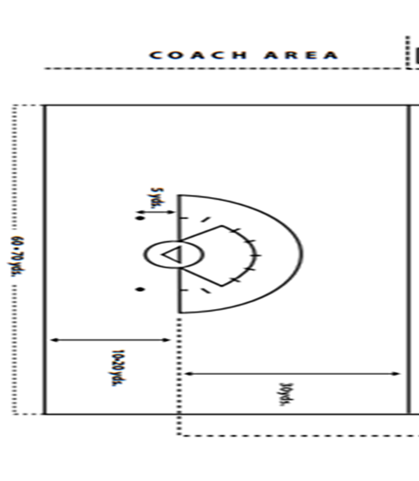
Penalty Administration
SLOW WHISTLE??
Minor Fouls:
If defense fouls within the 12M Free Position on the 12M, Offender goes 4M in the direction she approached, all players must be 4M away.
Indirect -she must pass, no direct shot.
8M Fan
12M Fan
Critical Scoring Area (CSA):
Goal line to 12M

Slide 39
Penalty Administration
SLOW WHISTLE??
If foul occurs below the goal line : Free positions below the goal line extended and in the critical scoring area shall be taken at one of the circles (dots) marked on the field
8M Fan
12M Fan
Critical Scoring Area (CSA):
Goal line to 12M

